Slide 1
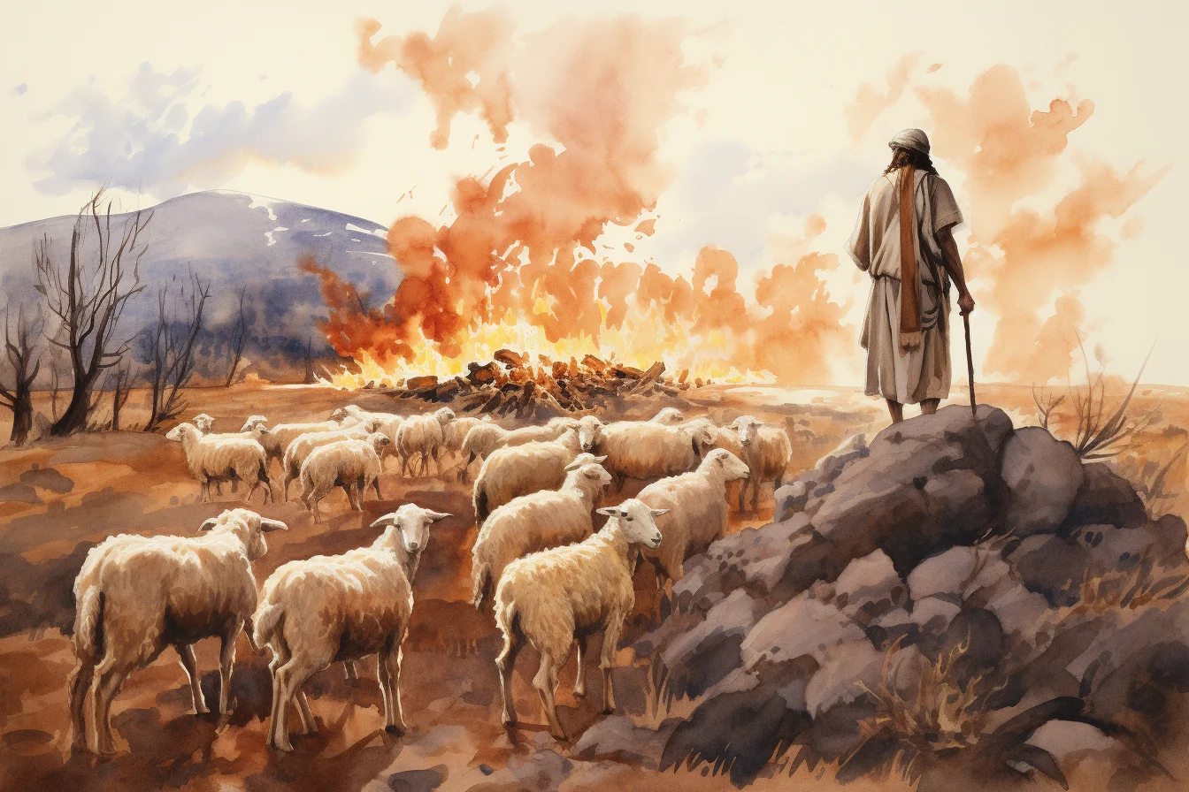
Exodus 出埃及記 3:1-11 Moses and Parenting
https://ffoz.org/torahportions/parashah/shemot
親子靈修 William分享
08-01-2025
 | Bible Reading Exodus 3:1-11 (Optional) | Time
1 | CUV in Chinese or Cantonese (Audio) | 4 min
2 | NIV Bible Reading in English (Audio) | 4 min
3 | Moses & Burning Bush English (ChildrenVideo) | 3 min
4 | Chinese Video | 6 min

Slide 2
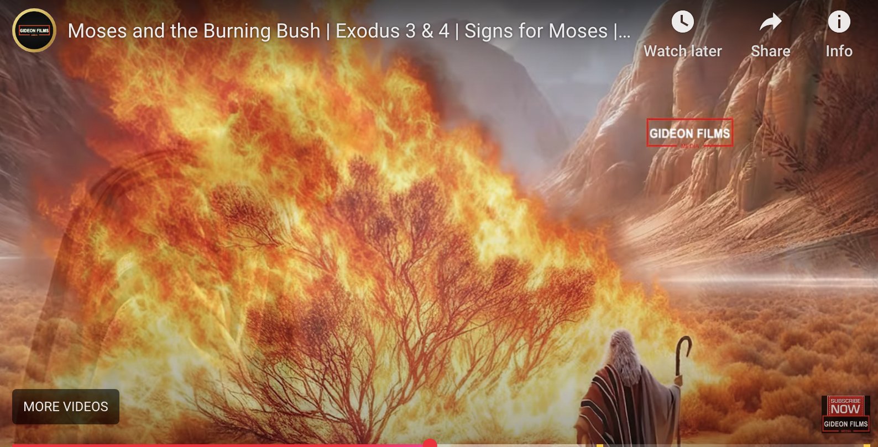
https://wdingbox.github.io/accc_2025_pp/ppt/Exodus/exo3_1_11.htm
Exodus 3:1-11. (Video Youtube)

Slide 3
出埃及記(Exodus) 3:1-11 簡介
經文取自《聖經和合本NIV》— 漢語聖經協會出版，承蒙允准使用。
Key Figures要人 | The Establishment of a Trilateral Relationship: God-Moses-Israelites (神-摩西-以色列人) 三边关系的建立
God | His Will; His Mission(Plan); His Calling; “I am the God of your fathers, the God of Abraham, the God of Issac, and the God of Jacob.” (3:6)
Moses 摩西 | 1. Aimless Life—a life not related to God’s Plan. (3:1) 2. Curiosity of the Great Sign (3:2-3) 3. Hearing of the Voice of God; (3:4a) 4. The 1st Response to the Voice of God: “Here I am.” (3:4b) 5. The 2nd Response without faith (3:11)
Israelites 以色列人 | Offspring of Abraham, Isaac, and Jacob. (3:6-10)

Slide 4
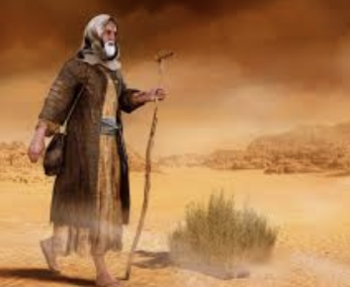
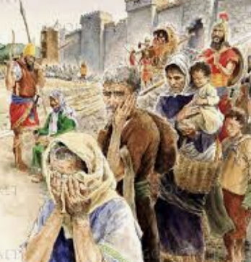
The Establishment of a Trilateral Relationship: God-Moses-Israelites (GMI) (神-摩西-以色列人) 三边关系的建立
“I have indeed seen the misery of my people in Egypt. I have heard them crying out because of their slave drivers, and I am concerned about their suffering” “我的百姓在埃及所受的困苦、我实在看见了．他们因受督工的辖制所发的哀声、我也听见了．我原知道他们的痛苦“ (3:7)
God
- “Moses Moses”
- “Here I am” “我在这里” (3:4b)
Israelites以色列人
"So now, go. I am sending you to Pharaoh to bring my people, the Israelites, out of Egypt." “我要打发你去见法老、使你可以将我的百姓以色列人从埃及领出来”
(3:10)
Moses

Slide 5
Verse Question
When the Lord saw that he had gone over to look, God called to him from within the bush, “Moses! Moses!” And Moses said, “Here I am.” (Exo3:4 NIV) 耶和华 神见他过去要看、就从荆棘里呼叫说、摩西、摩西．他说、我在这里。" (Exo3:4 CUVS) Why did the LORD call Moses’s name twice? “Moses, Moses” (3:4) 为什么耶和华的使者向摩西呼叫两次? A). for fun. B). important. C). Moses cannot hear. D). urgent

Slide 6
Theological Question
God is omnipotent. God is concerned about the Israelites’ suffering. Why didn’t God Himself save the Israelites directly? But rather call Moses to establish the triliteral relationship to save them? 上帝是全能的. 上帝关心以色列人的苦难. 为什么上帝不亲自拯救以色列人？而是呼召摩西,建立三边关系,来拯救他们？ Is it because Moses is more powerful than God? has special capability? Such as knowledgeable, well-educated, has leadership? grew up in a royal family? …

Slide 7
Parenting Question
What implications does Exodus 3:1-11 have for parenting? 出埃及记 3:1-11 对养育子女有什么启示？ How is the God-Moses-Israelites trilateral relationship related to the “God-Parents-Children” and “God-Husband-Wife” and “Jesus-Church-Christians” trilateral relationship? “神-摩西-以色列人” 与“神-父母-儿女”与“神-夫-妻”与 “耶稣-教会-基督徒“ 的三边关系有什么关联？ As the parents, did you hear the calling from God? Do you have a struggle? What are your concerns? What is your expectation of your children? 作为父母，你听到上帝的呼召了吗？你遇到过挣扎吗？你的担忧是什么？你对孩子的期望是什么？

Slide 8
個人反思 & 教養智慧
個人反思：
“我愿意献身给神，但我不愿意让孩子献身给神。我献身给神是为孩子” 对吗?
“I am willing to dedicate myself to God, but I am unwilling to let my children dedicate themselves to God. I dedicate myself to God for my children.” Is that right?
教養智慧：
"教养孩童、使他走当行的道、就是到老他也不偏离。" (Pro22:6 CUV)
"Train a child in the way he should go, and when he is old he will not turn from it." (Pro22:6 NIV)

Slide 9

Closing Prayer
Dear Heavenly Father, the Glorious Lord, the Creator, and Sovereign of all things. Thank you for your mercy and grace. Thank you for calling us, the parents. Thank you for giving us, the parents, the educational authority. Our children are your heritage. We are the sinners; we do not deserve it. May Your Holy Spirit call us, guide us. Bless our children and young generation to be able to know you, follow you to be the devotional generation. May your name be glorified, generation by generation, and forever. I pray in the name of Jesus. Amen.

Slide 10
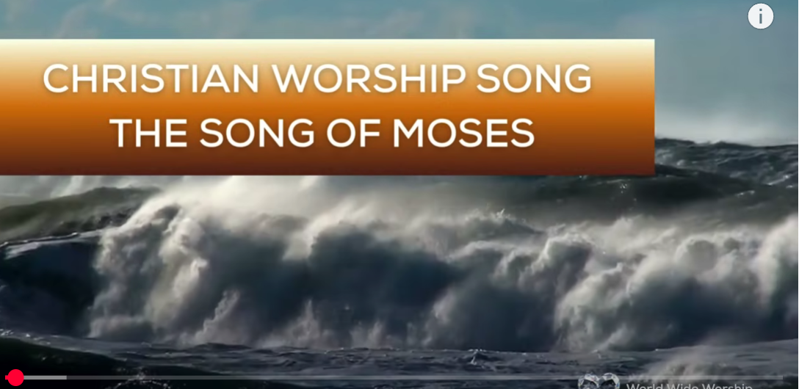
1. Here I am. (Kids)
https://www.youtube.com/watch?v=03G52K9X2hQ&list=RD03G52K9X2hQ&start_radio=1&ab_channel=Maranatha%21Music
2.No Turning Back
https://www.youtube.com/watch?v=s_vFAyOUvko&list=RDs_vFAyOUvko&start_radio=1&ab_channel=GaiseBaba
Christian Kids
3. Q&A for Children
4. The Song of Moses https://www.youtube.com/watch?v=a-wWKL-7Mrg
The Song of Moses Like You've Never Heard Before | Christian Worship Song/ World Wide Worship

